Slide 1
Phoneme/Text
Bijoy Singh (120050087)
Sai Kiran Mudulkar(120050068)
Manik Dhar(120050006)

Slide 2
Idea:
Train to HMMs using the CMU dataset.
One for word to phoneme conversion and the other for phoneme to word.
As the CMU dataset is tagged, this becomes a supervised learning problem.
We use the MLE to find HMM parameters and Viterbi to do the actual conversion.

Slide 3
Idea: (Contd.)
The transitions are of the form
S I ⇒| O |⇒ S II
Where O is the observation and S I and S II are the hidden states.
We have pruned the data set so that only words where the number of graphenes are equal to the number of phonemes are considered.

Slide 4
Idea: (Contd.)
For grapheme to phoneme conversion the states are the phoneme and graphemes are the observations.
The opposite is done when converting phonemes to graphemes.

Slide 5
Idea: (Contd.)
P(S I ⇒ | O | ⇒ S II) = n(S I ⇒ | O | ⇒ S II)/n(S I)
n(S I) = no of times S I appears in the data set.
n(S I ⇒ | O | ⇒ S II) = number of times S I is followed by SII in the dataset with O in the observation sequence corresponding to S II.

Slide 6
Implementation
We store a transition table to store the probabilities which we store in a file to avoid repeated training.
The phoneme sequence is made using the ARPABET notation. To produce sound we convert the output in ARPABET to ESpeak notation (IPA).
There is a GUI interface to do the conversion and sound production.

Slide 7
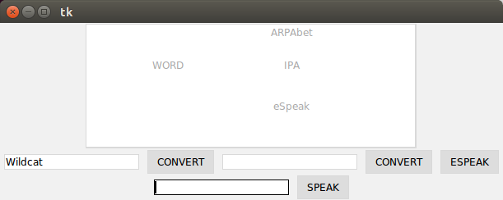
Interface
UI interface and API to allow for easier usage

Slide 8
Interface Properties
Allows for word to phoneme and phoneme to word conversion.
Word can be converted to IPA, ARPAbet or eSpeak notation.
The user can also simply enter a sentence which he or she wants to speak and it will speak it.

Slide 9
Performance:
We performed 5 fold cross validation after permuting the input set. The results are as follows:
Average Word Conversion Accuracy : 0.7338947118582697
Average Phoneme Conversion Accuracy : 0.8014263311120567

Slide 10
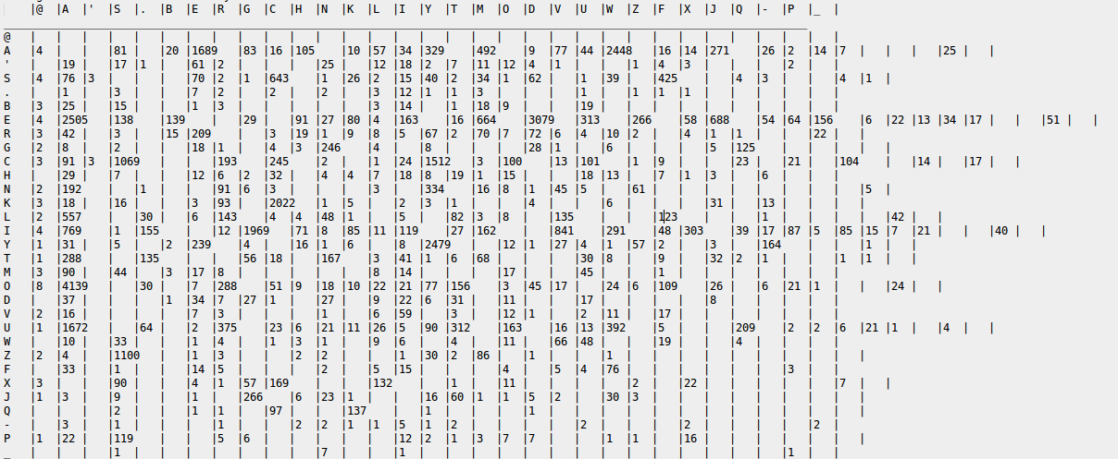
Confusion Matrix (GrGr)

Slide 11
Confusion Matrix (GrGr) conclusions
We can see that some alphabets are characteristic of being confused to others
A↔E,A↔O,S↔C, E↔I etc.
These confusion are legitimate as even english has these issues.

Slide 12
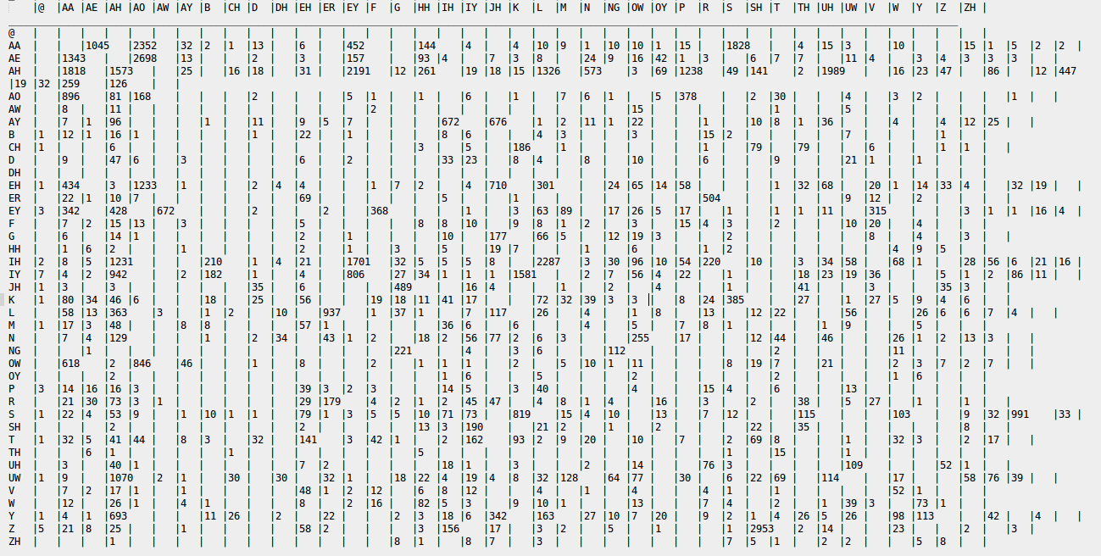
Confusion Matrix(PhPh)

Slide 13
Confusion Matrix (PhPh) conclusions
We can see that some phonemes are characteristic of being confused to others
AA↔AE,AA↔AH,OW↔AA, AH↔AE etc.
These confusion are legitimate as the sounds are close and their occurrences are in generally similar surrounding context.

Slide 14
Optimisation Attempts
Non Zero probability initially
Trigram Model
Neural Networks(Later)

Slide 15
Non Zero initial probability
The logic behind this is that many possibilities of the state diagram is nullified by the 0 probabilities existing due to no data seen for these transitions.
Instead of 0 we add 10-10 to allow for some weightage. We see not too much improvement of 0.01%(not much huh!)
Average Word Conversion Accuracy : 0.7430759192440042
Average Phoneme Conversion Accuracy : 0.8014293446848637

Slide 16
Trigram:
We changed the state machine to work with trigrams. The results were as follows:
Average Word Conversion Accuracy : 0.6153025931351043
Average Phoneme Conversion Accuracy : 0.7398425392381858

Slide 17
Trigram Output Analysing
The performance of the machine reduces with the trigram assumption(besides it takes significantly more time to solve), this is expected for the reason that the new state transistion ((S1,S2),S3,O) requires more training to get trainined and that the english model for equi-phone-grapheme words may not be too much effected by this assumption.

Slide 18
Thank You

